Slide 1
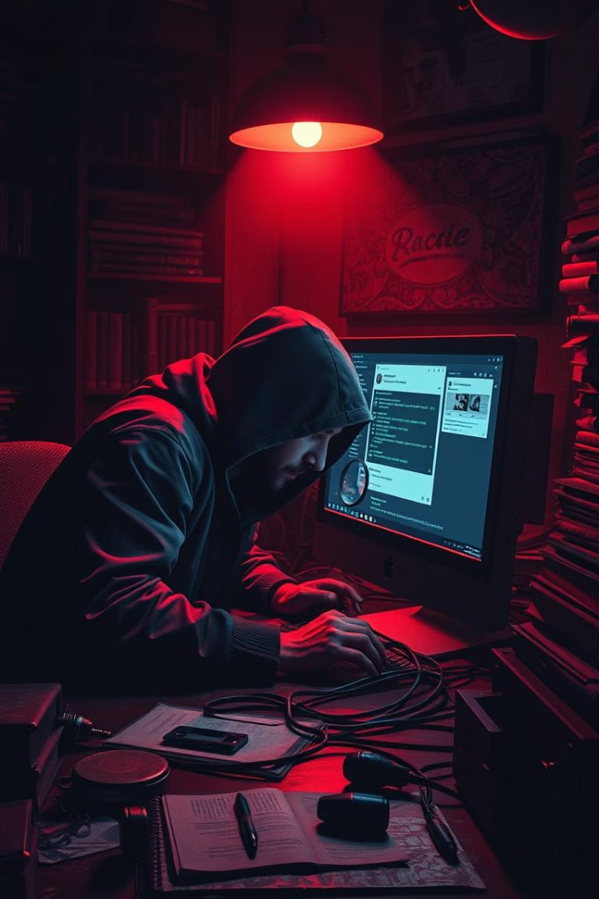

Phishing Awareness Training
Recognizing and Avoiding Phishing Attacks
by Mudasir Jamali

Slide 2
What is Phishing?
Definition
Objective
Phishing is a cyber attack that uses deceptive tactics to trick people into revealing sensitive information, like passwords and credit card numbers.
This training will teach you to identify and avoid phishing attempts to protect your personal and organizational data.

Slide 3

Common Phishing Attacks
Email Phishing
Spear Phishing
Mass emails pretending to be from legitimate sources. Example: Emails claiming a bank account is frozen.
Targeted attacks directed at specific individuals or organizations. Example: Emails posing as a coworker requesting a wire transfer.
Whaling
Vishing & Smishing
Phishing attacks aimed at high-profile targets like executives. Example: Emails mimicking a CEO's assistant.
Vishing is phishing via phone calls. Smishing is phishing through text messages.

Slide 4
Identifying Phishing Emails
1
Generic Greetings
2
Urgent Language
3
Suspicious Links/Attachments
Use of non-specific salutations like "Dear Customer."
Phrases creating a sense of urgency like "Immediate action required!"
Unexpected links or files.
4
Poor Language Quality
5
Unusual Sender Addresses
Spelling and grammatical errors.
Email addresses that do not match the organization’s domain.

Slide 5
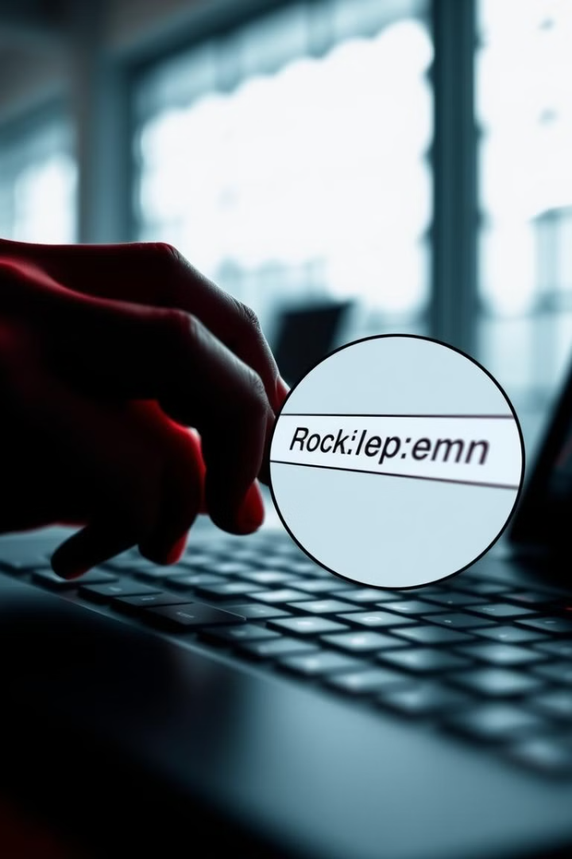


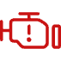
Analyzing Links & URLs
Hover Over Links
Check for HTTPS
Always hover over links to reveal the actual URL before clicking.
Ensure the URL begins with "https://" for a secure connection.
Look for Misspellings
Be cautious of domains with slight misspellings.

Slide 6
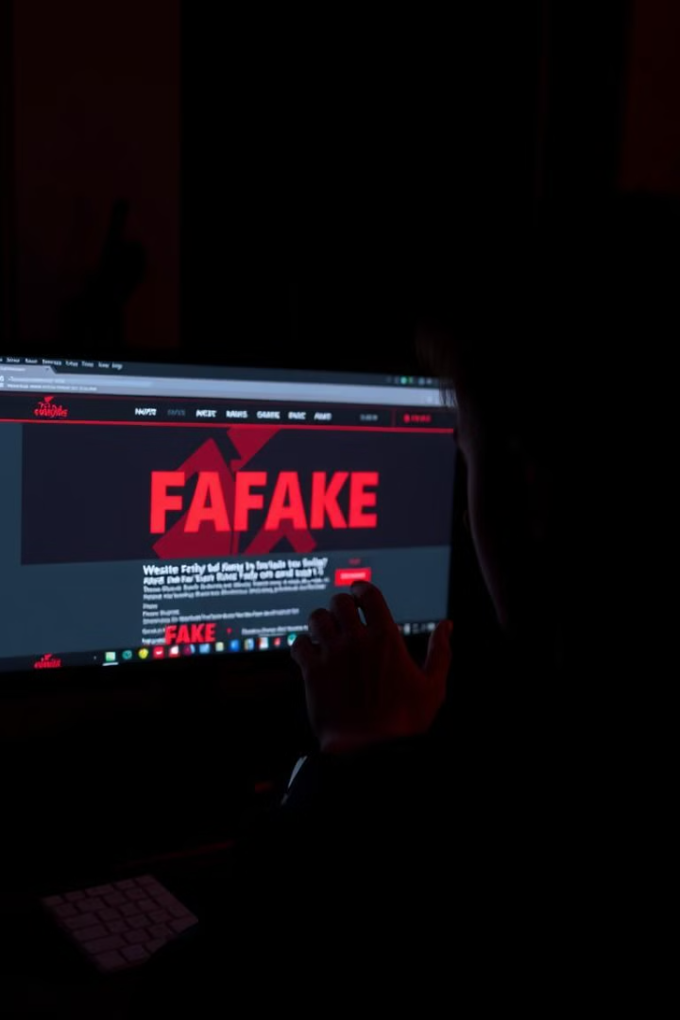




Spotting Phishing Websites
Unusual Domain Names
Variations in domain names (e.g., using .net instead of .com).
Lack of Contact Information
Absence of legitimate contact details.
Poor Design
Websites that appear unprofessional or poorly constructed.
Requests for Sensitive Information
Legitimate organizations will not ask for sensitive data via email.

Slide 7



Understanding Social Engineering
Impersonation
1
Pretending to be a trusted individual or organization.
Creating Urgency
2
Instilling fear or urgency to prompt hasty actions.
Too Good to Be True Offers
3
Promotions or prizes that seem unrealistic.

Slide 8
Key Takeaways
Phishing Attacks Are Prevalent
1
These threats can have severe consequences.
Awareness and Vigilance Are Essential
2
They're crucial defenses against phishing attacks.
Always Verify the Authenticity
3
Of requests for sensitive information.

